Slide 1
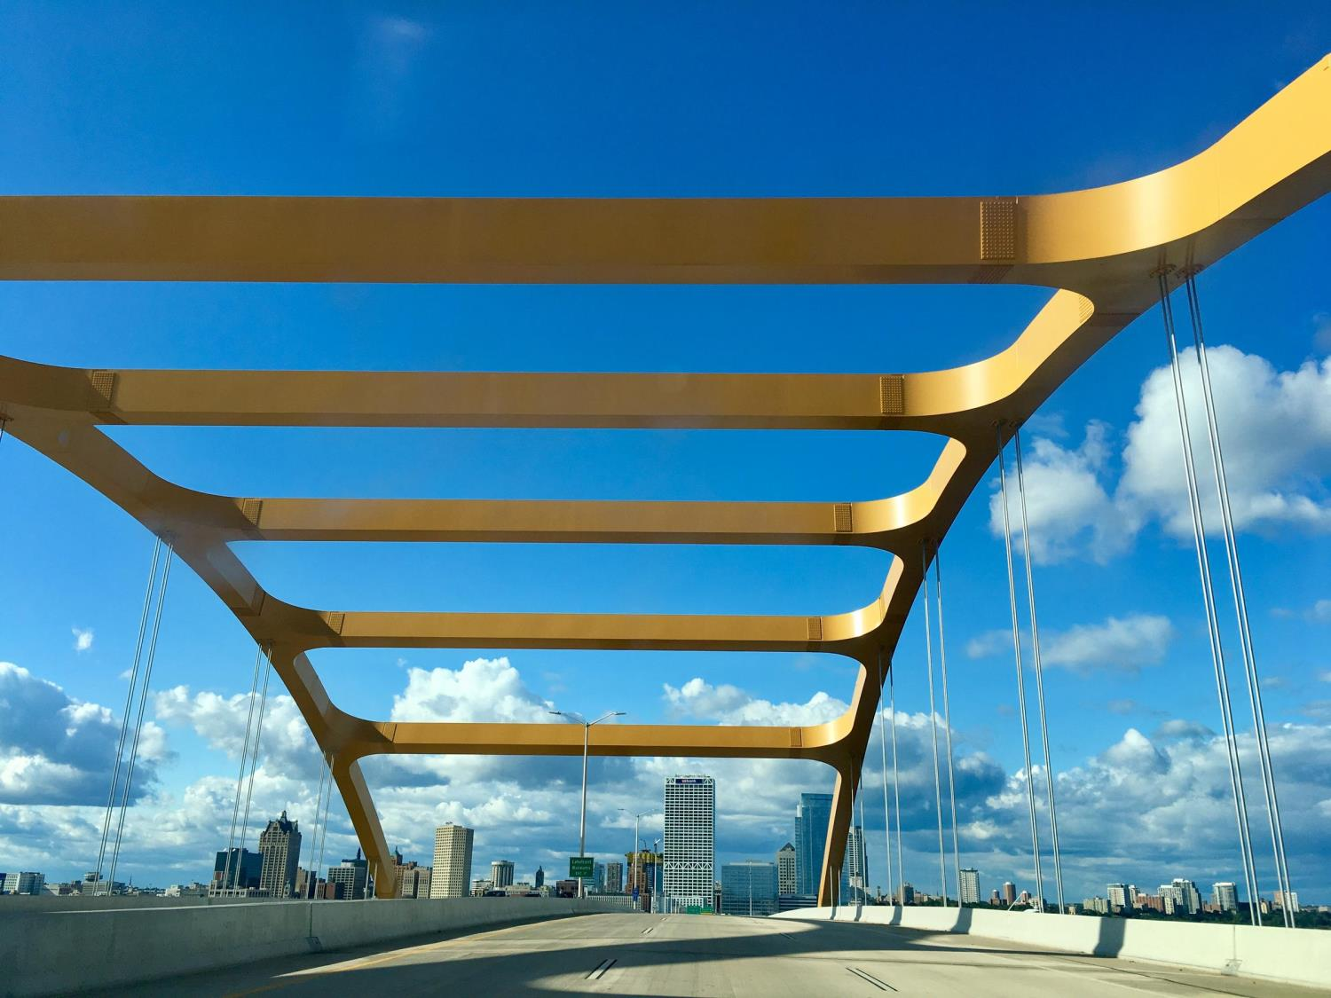
One Bridge
Bringing Business & Technology Together
Crowded House Innovators::
Awais Sultan, Stacie Kenney, Pawan Tipre
Notes:
Note: This is the Hoan bridge, in Milwaukee, with the US Bank tower in the background ;-)

Slide 2
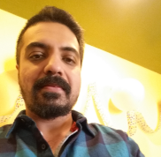
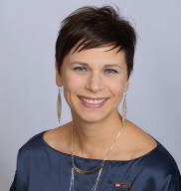
Crowded House Innovators
FOUNDER
Awais is a current BPM Architect for TOS and the brain child of this big idea. He is so good at delegating tasks, one might wonder if he does any actual work himself. Awais likes long walks on the beach and sharing coffee with friends.
CO-FOUNDER / TEAM MEMBER
Stacie works as a Business Process Analyst, helping business folks improve and automate their processes. She was brought into this madness by Awais and then recruited the rest of the team. Stacie likes big dogs and she cannot lie!

Slide 3


HUNCH
There are a few existing systems that do part of the job
We believe by creating a cohesive and collaborative solution, where the business and technology can come together, we can drive greater problem solving and implementation of ideas.
Essentially...
Creating – One Bridge (from Business to Technology)
Changing tough office work
… to kids play!

Slide 4







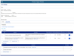
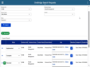
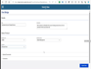
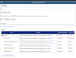
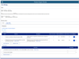
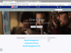

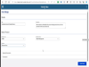
FUTURE
Journey
SCENARIO:
Ideas are collected to improve products.
GOALS & EXPECTATIONS:
Employees and product owners want to bring ideas to fruition.
One Dashboard shows status for ideas that also reports completed ideas that creates excitement for Natalie and Christina.
A dedicated team reviews all the One Bridge entries and determines the best home for resolution, all while keeping Natalie updated on progress.
Christiana review ideas submitted in her ideas intake tool and add them to OKRs.
Campaign is conducted to collect ideas from employees
Christiana contacts her TOS lead and also look at technology village to find additional resources
Natalie goes to one stop shop to submit her idea.
Idea / Problem Home
2
6
3
4
1
5
Value Proposition:
- The feeling of winning in the workplace can be very empowering.
Value Proposition:
- Ideas and problems occur throughout the day. This is natural.
Value Proposition:
- Marketing for One Bridge will be multi channel and recurring.
Value Proposition:
- Having a dedicated team with varied experiences working together is optimal.
Value Proposition:
- Improves product modeling, incorporating brilliant ideas
Value Proposition:
- Improves product modeling, incorporating brilliant ideas

Slide 5
Let’s collaborate. Thank you.
Questions

Slide 6




Current
Journey
SCENARIO: Natalie has an idea about a business problem she would like to solve.
Natalie comes up with a great idea for improving the way her team works.
She’s not sure where to share this idea, so she starts with USBNet, and also asks around.
Frustration sets in as she searches, and finds no logical place for her idea, since many options handle specific issues only.
Natalie asks around her team for answers but finds none.
Natalie gives up and goes back to work.
1
4
2
3
5
Opportunity:
- Ideas and problems occur throughout the day.
Pain point:
- One place to submit ideas is missing or not properly advertised.
SCENARIO: Christina who is leading a business group wants to continuously improve products they offer and likes to collect ideas.
Christiana has an ideas intake tool; she looks at it regularly.
Christian sees very few to none ideas submitted to idea intake tool.
Christiana wonders around how to encourage his team and create culture of ideation and to collect more product ideas
1
3
2
Pain point:
- Although some idea intake tools exist, but few ideas to none are coming through.
Opportunity:
- A campaign to collect ideas for a product can encourage and expand culture of ideation and collect more product ideas.

Slide 7
Current
Journey
SCENARIO: Natalie has an idea about a business problem she would like to solve.
Natalie comes up with a great idea for improving the way her team works.
She’s not sure where to share this idea, so she starts with USBNet, and also asks around.
Frustration sets in as she searches, and finds no logical place for her idea, since many options handle specific issues only.
Natalie asks around her team for answers but finds none.
Natalie gives up and goes back to work.
1
4
2
3
5
Opportunity:
- Ideas and problems occur throughout the day.
Pain point:
- Ideas submitted in Enterprise tools stay there and don’t move forward. Triage process to submit ideas to right business group is missing
SCENARIO: Christina who is leading a business group wants to continuously improve products they offer and likes to collect ideas.
Christiana has an ideas intake tool; she looks at it regularly.
Christian sees very few to none ideas submitted to idea intake tool.
Christiana wonders around how to encourage his team and create culture of ideation and to collect more product ideas
1
3
2
Pain point:
- Integrated workflow through different tools involved in ideation is missing

Slide 8
Current
Journey
SCENARIO: Natalie has an idea about a business problem she would like to solve.
Natalie comes up with a great idea for improving the way her team works.
She’s not sure where to share this idea, so she starts with USBNet, and also asks around.
Frustration sets in as she searches, and finds no logical place for her idea, since many options handle specific issues only.
Natalie asks around her team for answers but finds none.
Natalie gives up and goes back to work.
1
4
2
3
5
Opportunity:
- Ideas and problems occur throughout the day.
Pain point:
- Product owners are not sure who to go to, to get technical advice and find right technical resources for ideas coming in.
SCENARIO: Christina who is leading a business group wants to continuously improve products they offer and likes to collect ideas.
Christiana has an ideas intake tool; she looks at it regularly.
Christian sees very few to none ideas submitted to idea intake tool.
Christiana wonders around how to encourage his team and create culture of ideation and to collect more product ideas
1
3
2
Pain point:
- Absence of any technology village to find additional resources who have availability and skills to work on the idea.

Slide 9






OPPORTUNITY
Most employees don’t know where to go with problems or ideas!
Streamline the process to encourage culture of bringing up new ideas/ improvement ideas through campaigns and then bring those ideas into fruition by plugging them into how we do things (Product Modeling).
The opportunity we see is to build a workflow which starts with one stop shop for problems and solution ideas, which can leverage and integrate with some of the existing tools already in place, and refining those or the processes around them.
To offer technology village (Assigning right technology experts/developers, availability of developers who can offer their extra hours) to businesspeople/product owners to implement trending features.
One Bridge - from Business to Technology The only place you need to go for turning ideas or problems into future possibilities.
Idea / Problem Home
Notes:
PROBLEM
Our survey and the resulting synthesis confirmed this hunch.
There was no ONE solution that people sought with their problems or ideas
Currently people are using whatever means they have based on their own experiences, that work well for them
OPPORTUNITY
We also know that there will need to be a lot of communication around the new solution, as well as an annual training element, so that all employees know about this solution and how to use it.

Slide 10
MARKET
Everyone; the problem doesn’t discriminate and neither does our solution
Primary = US Bank Business Line
This problem is worth solving, because it directly correlates to our strategy where we need to continually improve the way in which we work today.
We now also have Yammer and other workplace tools we didn’t have before, which can help us reach more employees than before.
We are not aware of any internal projects or efforts addressing this problem, but we do know that each business line has its own approach to maintaining their own procedures and process collateral.
Secondary = US Bank Customers
If the employees are not operating at their best, then they cannot deliver their best to our customers.
One Bridge - from Business to Technology The only place you need to go for turning ideas or problems into future possibilities.
Idea / Problem Home

Slide 11

NEXT STEPS
Future of Innovation. . .
Understand business line ideation process.
Discuss and then create a campaign. We can discuss what should be the ask for the campaign, what quarter will work for the campaign etc.
Demo of OneBridge process, basically integrated workflow involving different ideation tools including business line ideation tools to present idea intake and triage process that can help accelerate ideation.

Slide 12
One Bridge - from Business to Technology The only place you need to go for turning ideas or problems into future possibilities.
Idea / Problem Home

Slide 13
Current
Journey
SCENARIO:
Natalie has an idea about a business problem she would like to solve.
GOALS & EXPECTATIONS:
Natalie wants to share her idea with the right resources.
Natalie expects to easily find some place to share her idea.
Frustration sets in as she searches, and finds no logical place for her idea, since many options handle specific issues only.
Natalie asks around her team for answers, but finds none.
Natalie comes up with a great idea for improving the way her team works.
She’s not sure where to share this idea, so she starts with USBNet, and also asks around.
Natalie gives up and goes back to work.
1
4
2
5
3
Opportunity:
- Ideas and problems occur throughout the day.
Opportunity:
- Depending on where Natalie works, she can have many options to pursue.
Opportunity:
- Frustration can lead to job dissatisfaction.
Opportunity:
- When ideas cannot be easily shared then they are learned to be stifled and become missed opportunities.

Slide 14
CUSTOMERS
Everyone; the problem doesn’t discriminate and neither does our solution
Primary = US Bank Business Line
Everyone has the problem of not really knowing where to go with an issue or solution idea.
The problem is costing the bank valuable resource time whereby instead of the employee doing their daily job, they’ve encountered a problem or idea and want to make their job more efficient or less problematic, so now they spend time looking for where to go.
Secondary = US Bank Customers
If the employees are not operating at their best, then they cannot deliver their best to our customers.
Notes:
- Even though TOS folks routinely support the implementation of solution ideas, they can also have ideas of their own to improve how they deliver, support, etc.
- They will ask their manager or someone else they know who might be able to point them in the right direction.
- They may submit a request via some BL specific process whereby it’s not managed well and therefore doesn’t provide timely responses.
- We know all of this based on our survey synthesis.

Slide 15
MARKET
External
The team believes the toolset available at the bank currently is robust enough to satisfy the need at hand. Therefore, we don’t feel the need to expend effort to review external solutions at this time.

Slide 16
Current
Journey
SCENARIO:
Natalie has an idea about a business problem she would like to solve.
GOALS & EXPECTATIONS:
Natalie wants to share her idea with the right resources.
Natalie expects to easily find some place to share her idea.
Frustration sets in as she searches, and finds no logical place for her idea, since many options handle specific issues only.
Natalie asks around her team for answers, but finds none.
Natalie comes up with a great idea for improving the way her team works.
She’s not sure where to share this idea, so she starts with USBNet, and also asks around.
Natalie gives up and goes back to work.
1
4
2
5
3
Opportunity:
- Ideas and problems occur throughout the day.
Opportunity:
- Depending on where Natalie works, she can have many options to pursue.
Opportunity:
- Frustration can lead to job dissatisfaction.
Opportunity:
- When ideas cannot be easily shared then they are learned to be stifled and become missed opportunities.

Slide 17
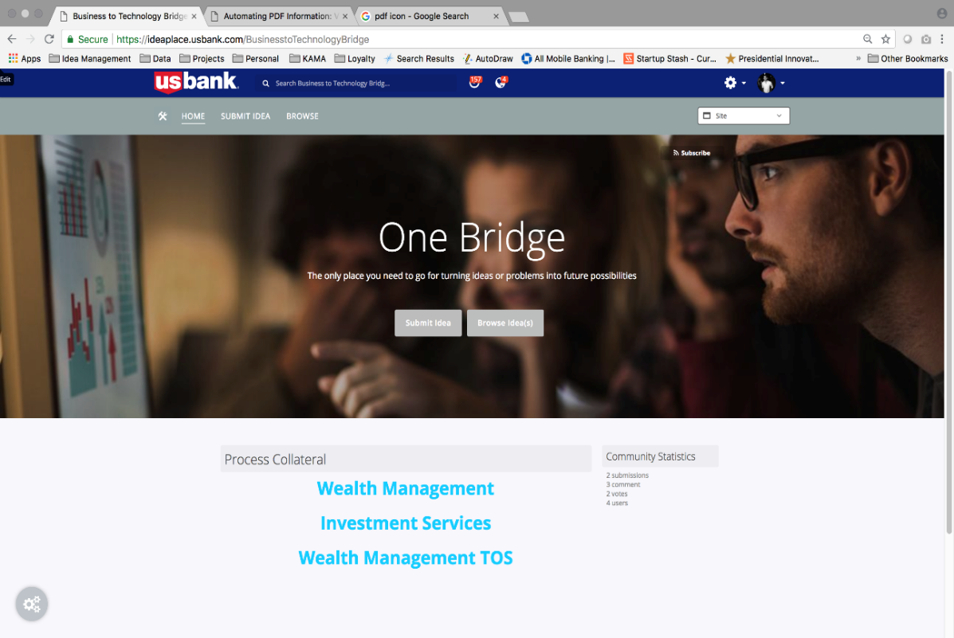
Leadership Buy in: US Bank initiative inviting business lines leadership to submit business issues.

Slide 18
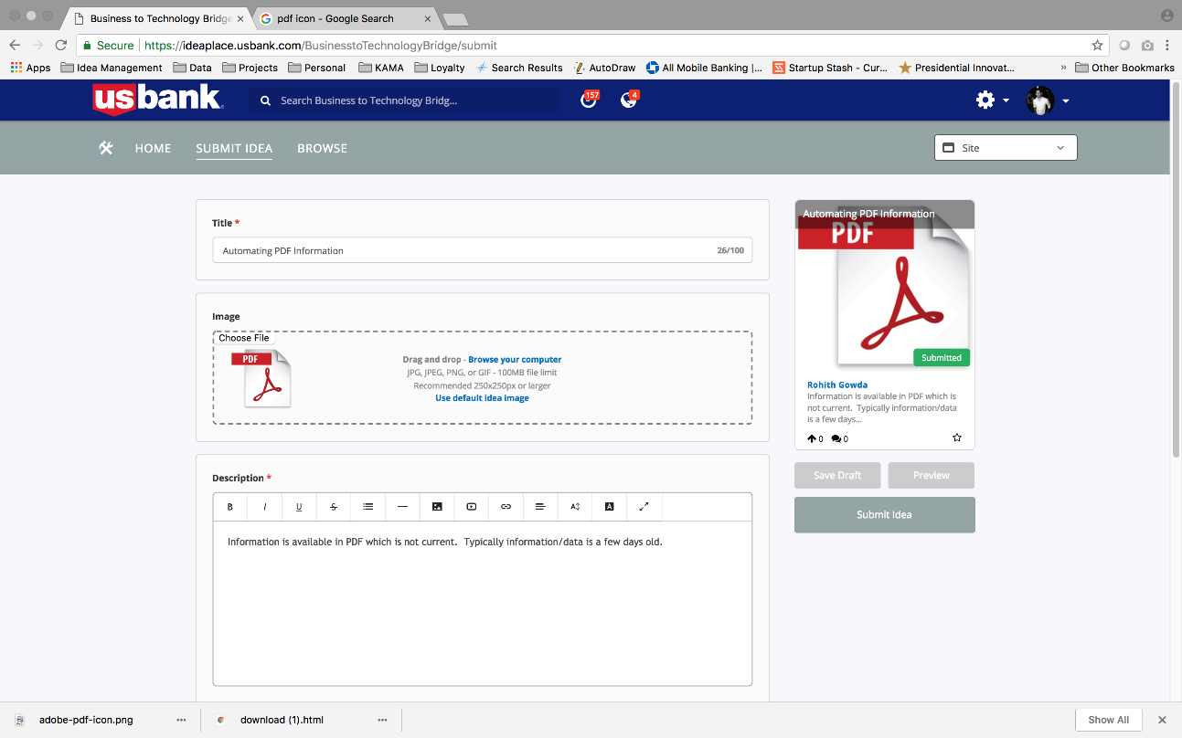
Submit Business Issue: Business issue description, attachments.

Slide 19
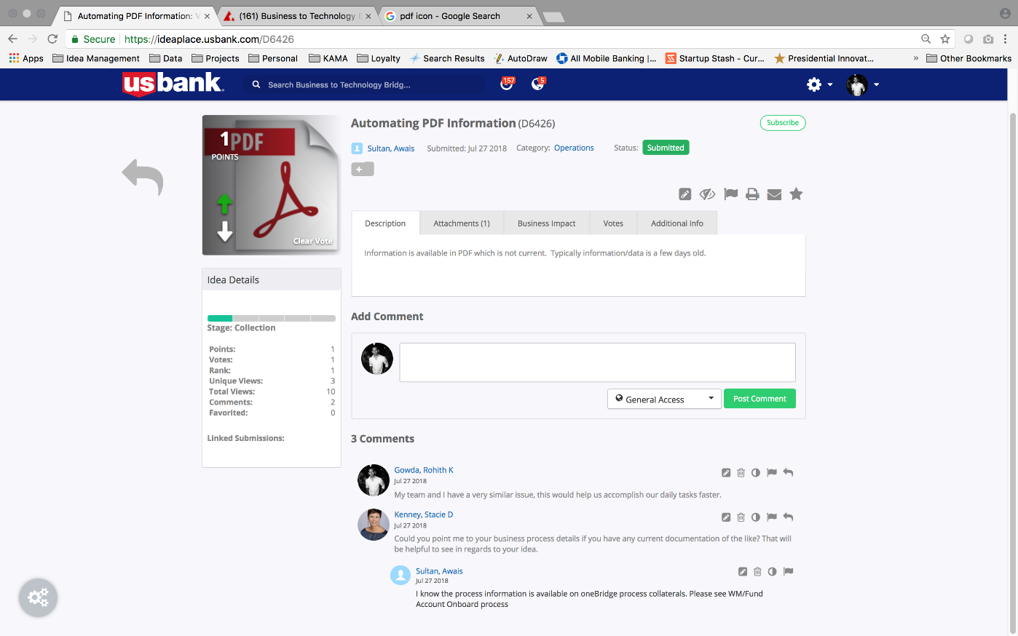
Collaboration: Collaboration on business issue between business users, COE, leadership.

Slide 20
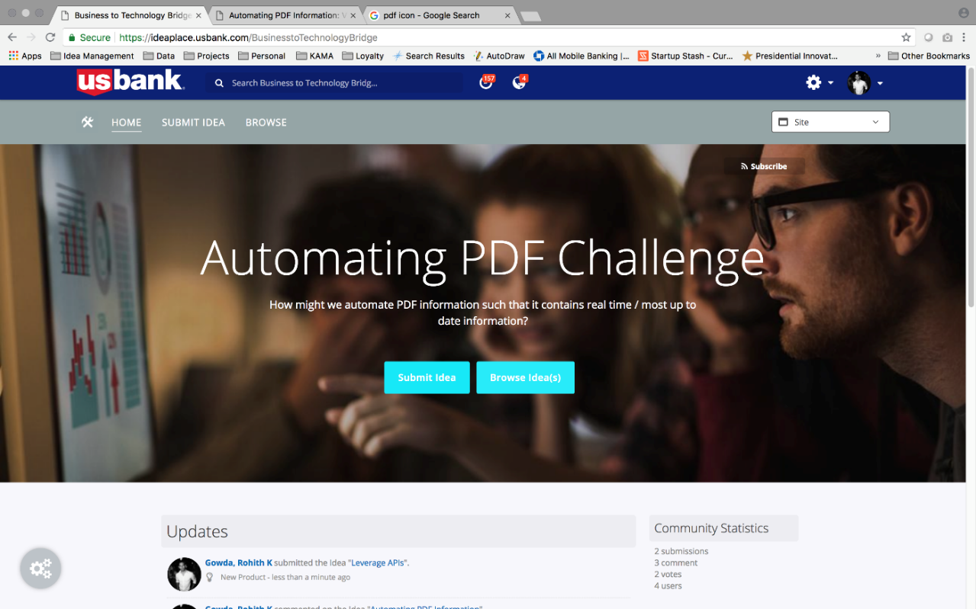
Move on to Ideation: Business issues will be posted as business Challenges in Ideaplace Or Bright Ideas Or CapEx committee can take over.

Slide 21
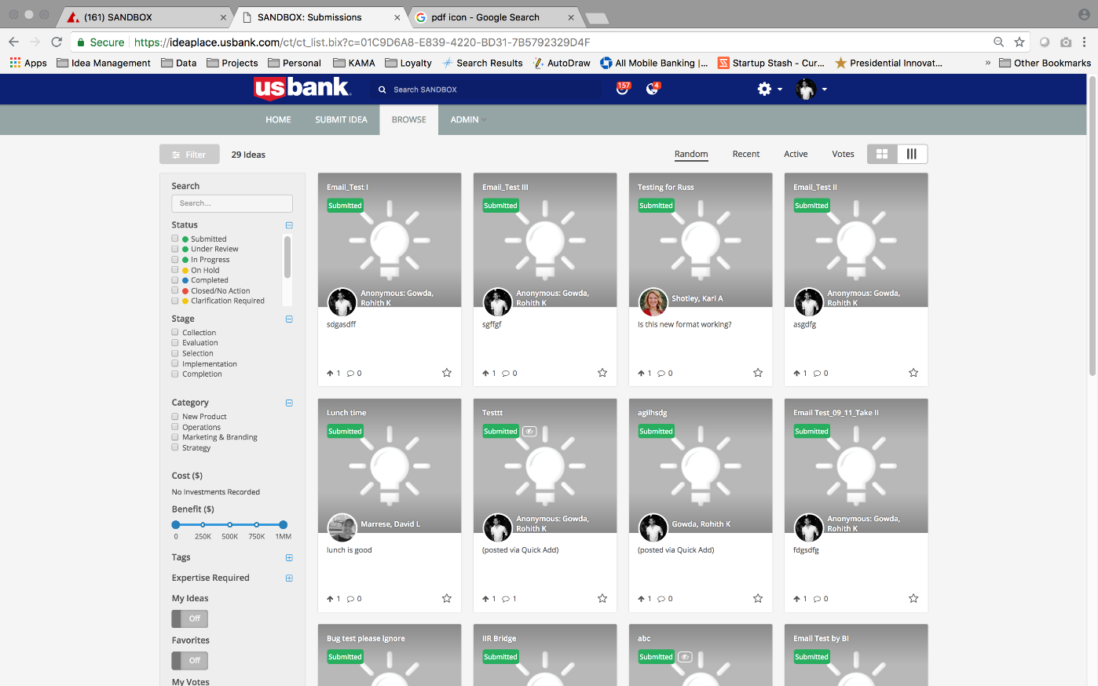
Ideas/Solutions for Business Challenge: Several ideas/ solutions can be posted by innovation groups/ TOS teams to solve business issue/challenge.

Slide 22
Value Propositions
Simplify your job. Increases Efficiency.
Streamlines process and Invites collaboration on business issues
Makes our job easier and simpler.
Better experience for our customers.
One Stop Shop for business processes information and to solve business issues
Powerful combo of domain expert and technical people.
One Bank
Improves Efficiency
Increases Revenue

Slide 23
Lessons Learned
We learned a lot through this awesome IIR journey.
Learned to always test our theory and hunch.
Improved experimentation/ interview techniques.
Met new people.
Learned great tools like IdeaPlace, Yammer, InVision.
Increased skillset through great workshops; Design Worskhop, Customer Empathy Map, Primary/Secondary Research, Journey Maps, Story Telling.
IIR is awesome.

Slide 24
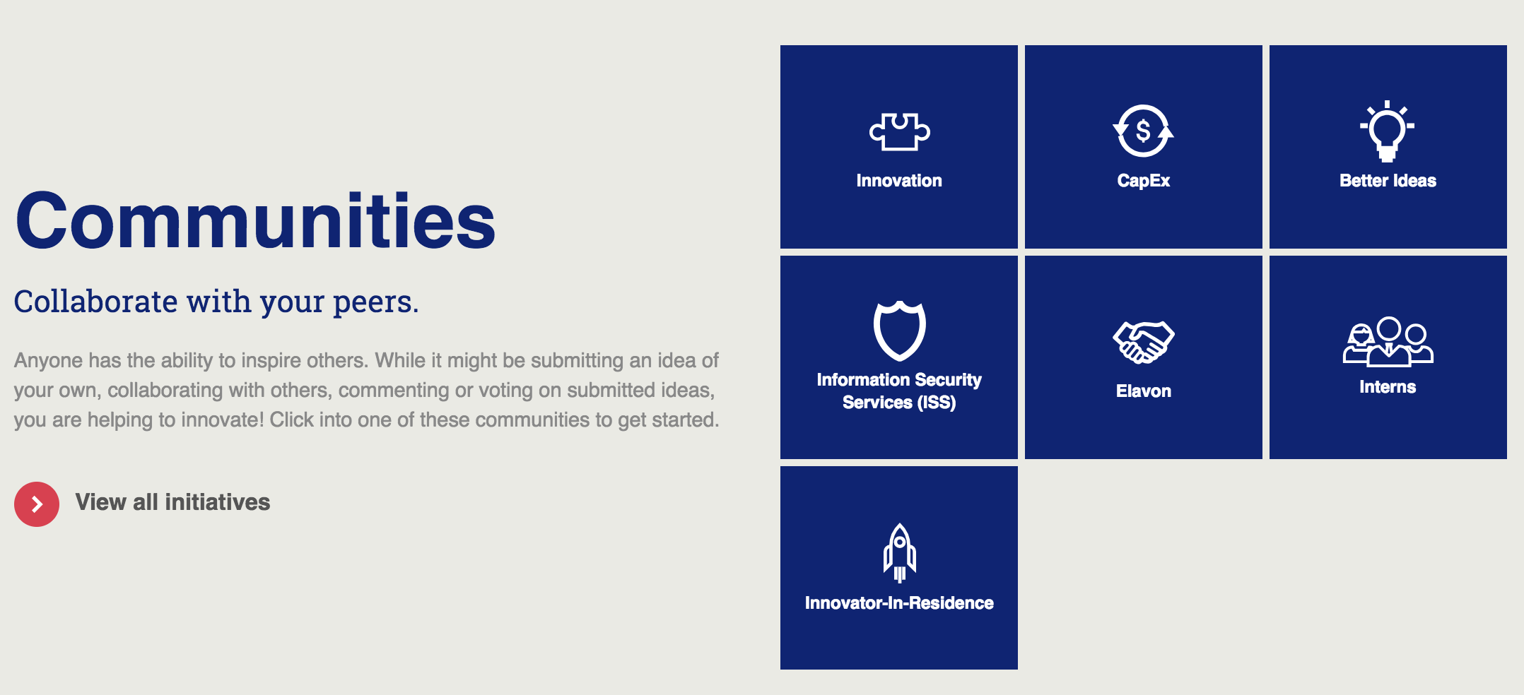
Appendix A -
[How this is different from IdeaPlace?]
[IdeaPlace is the platform, whereas OneBridge is the program. OneBridge will offer collaboration on business issues and will house business process information. OneBridge will gather business issues and improve connections with other tools so that problems move on seamlessly to ideation. Please see below an example of another program “Bright Ideas” using IdeaPlace as platform]

Slide 25
PROBLEM
Most employees don’t know where to go with problems or ideas!
Problems / Paint Points:
Although tools exist like some idea intake tools, but few ideas are coming through.
Business employees have some ideas but don’t know where to submit the ideas and one place to submit ideas is missing.
If ideas are submitted at enterprise tools, then they just stay there and don’t move forward towards next steps. Triage process to evaluate those ideas, prioritize those ideas and submit them to right intake tools where they can become part of OKRs is missing.
Integrated workflow of different tools involved in ideation, some at enterprise level, some at business line level (like Dragonboat) is missing.
Product owners are not sure who to go to, to get technical advice and find right technical resources for ideas coming in.
Absence of any technology village to find additional resources who have availability and skills to work on the idea.
Notes:
PROBLEM
Our survey and the resulting synthesis confirmed this hunch.
There was no ONE solution that people sought with their problems or ideas
Currently people are using whatever means they have based on their own experiences, that work well for them
OPPORTUNITY
We also know that there will need to be a lot of communication around the new solution, as well as an annual training element, so that all employees know about this solution and how to use it.

Slide 26
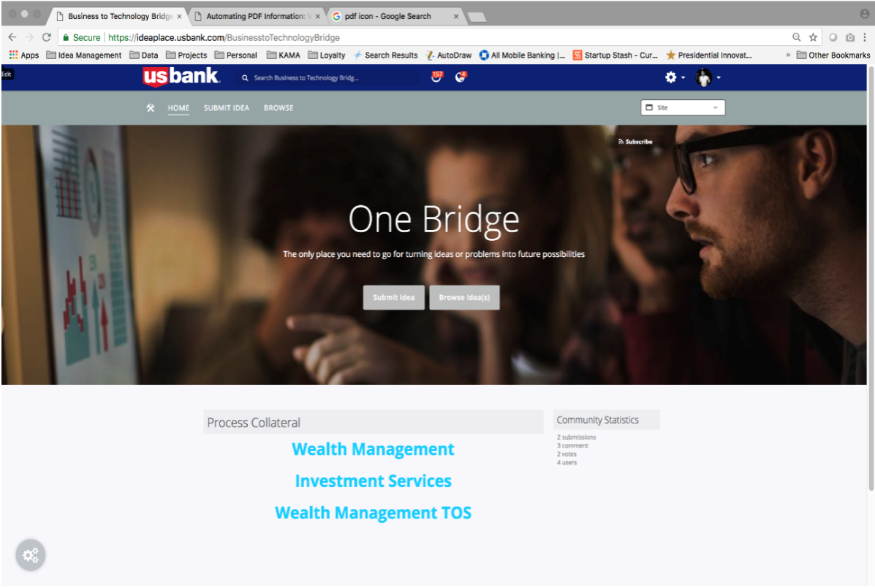
Notes:
PROBLEM
Our survey and the resulting synthesis confirmed this hunch.
There was no ONE solution that people sought with their problems or ideas
Currently people are using whatever means they have based on their own experiences, that work well for them
OPPORTUNITY
We also know that there will need to be a lot of communication around the new solution, as well as an annual training element, so that all employees know about this solution and how to use it.

Slide 27
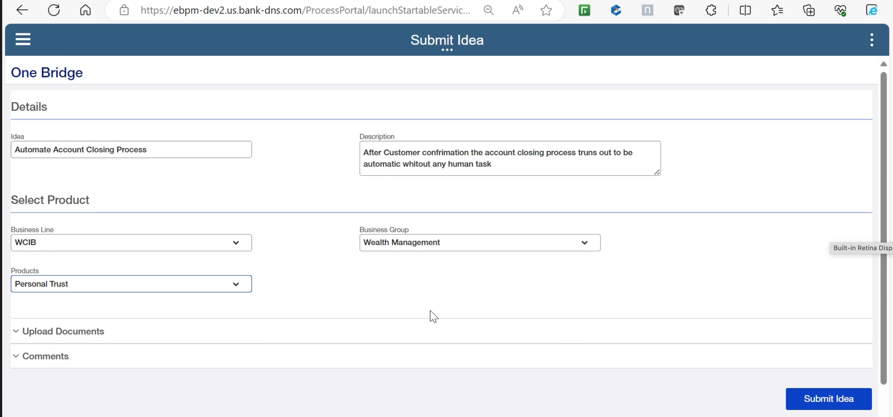
Notes:
PROBLEM
Our survey and the resulting synthesis confirmed this hunch.
There was no ONE solution that people sought with their problems or ideas
Currently people are using whatever means they have based on their own experiences, that work well for them
OPPORTUNITY
We also know that there will need to be a lot of communication around the new solution, as well as an annual training element, so that all employees know about this solution and how to use it.

Slide 28
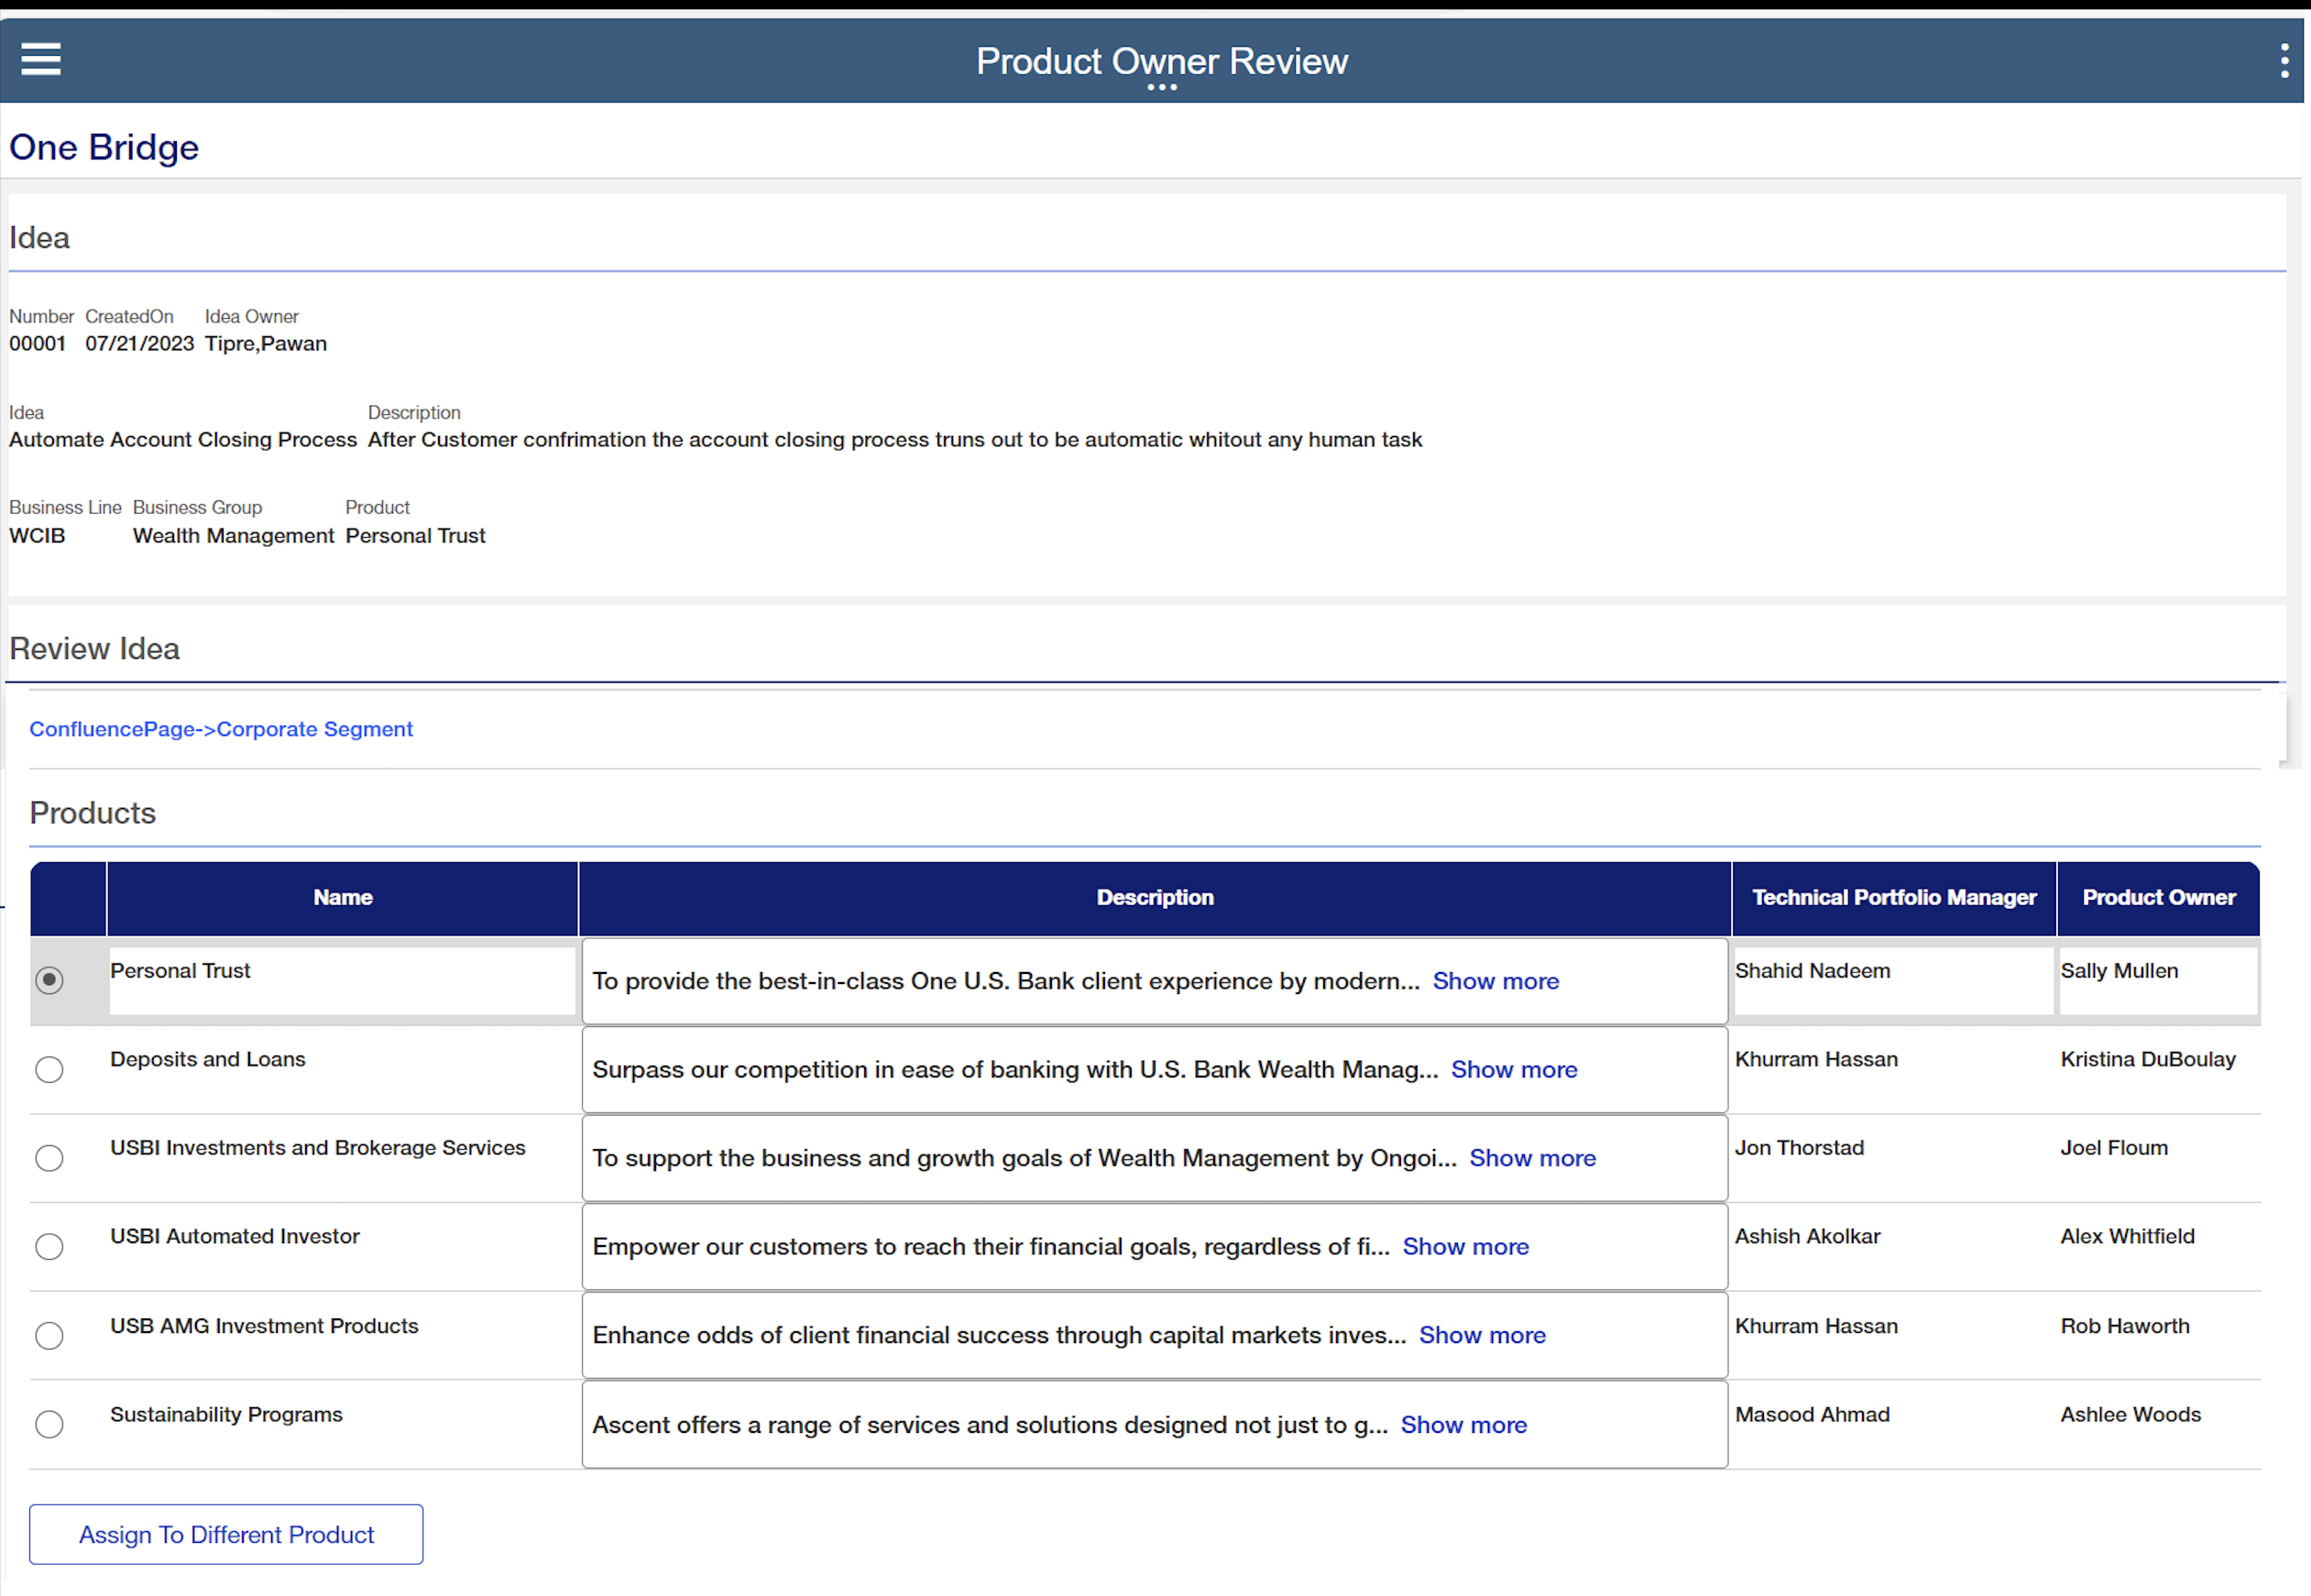
Notes:
PROBLEM
Our survey and the resulting synthesis confirmed this hunch.
There was no ONE solution that people sought with their problems or ideas
Currently people are using whatever means they have based on their own experiences, that work well for them
OPPORTUNITY
We also know that there will need to be a lot of communication around the new solution, as well as an annual training element, so that all employees know about this solution and how to use it.

Slide 29
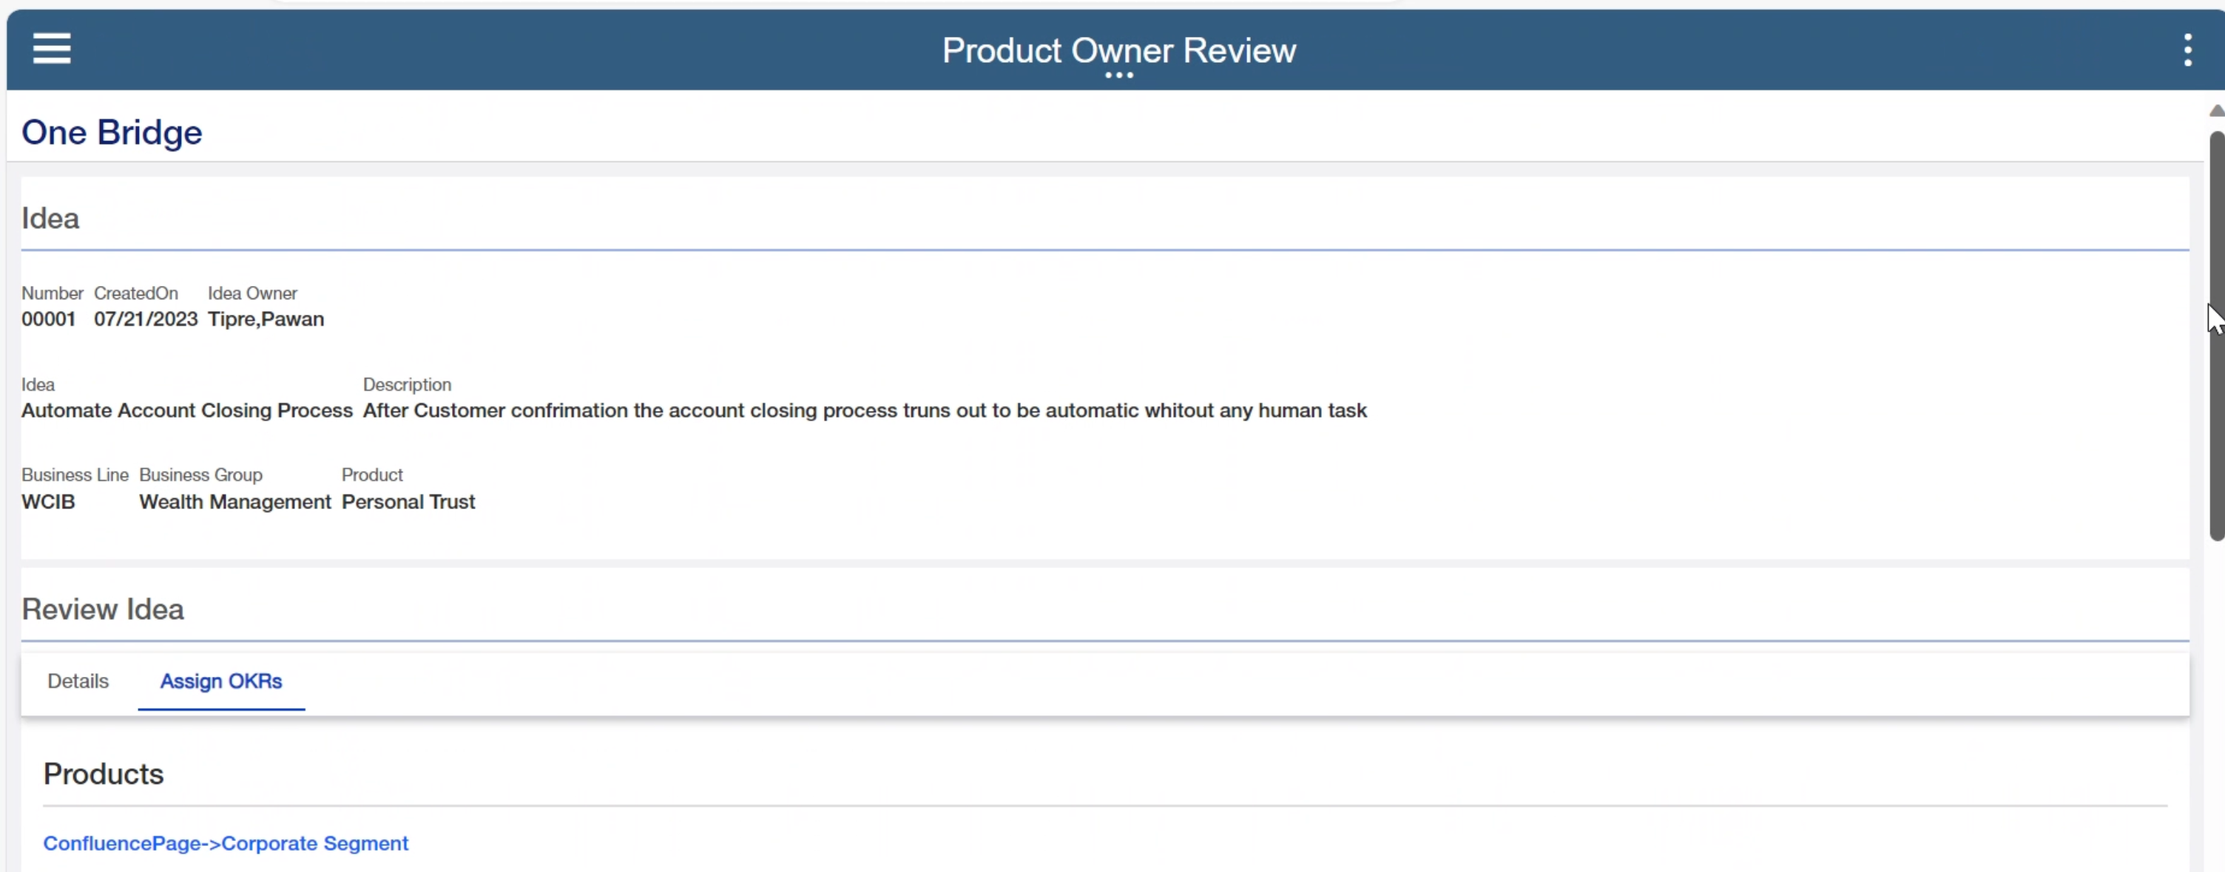
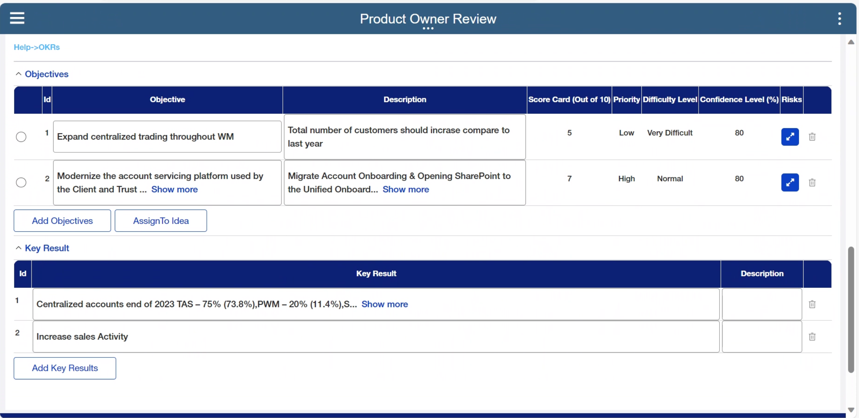
Notes:
PROBLEM
Our survey and the resulting synthesis confirmed this hunch.
There was no ONE solution that people sought with their problems or ideas
Currently people are using whatever means they have based on their own experiences, that work well for them
OPPORTUNITY
We also know that there will need to be a lot of communication around the new solution, as well as an annual training element, so that all employees know about this solution and how to use it.

Slide 30

Notes:
PROBLEM
Our survey and the resulting synthesis confirmed this hunch.
There was no ONE solution that people sought with their problems or ideas
Currently people are using whatever means they have based on their own experiences, that work well for them
OPPORTUNITY
We also know that there will need to be a lot of communication around the new solution, as well as an annual training element, so that all employees know about this solution and how to use it.

